Slide 1

Introduction
This project aims to analyze a comprehensive dataset from a retail store chain to uncover insights into sales performance. By examining various metrics such as total profit, items sold, losses, customer demographics, and purchasing behaviors, the goal is to derive meaningful information that can drive strategic business decisions.

Slide 2

Objective
The objective is to understand the store's performance across different categories and regions, identify trends in customer preferences, and detect areas of profit and loss. This will inform the management team on potential areas for growth, cost reduction, and customer engagement strategies.

Slide 3

Visualization

Slide 4

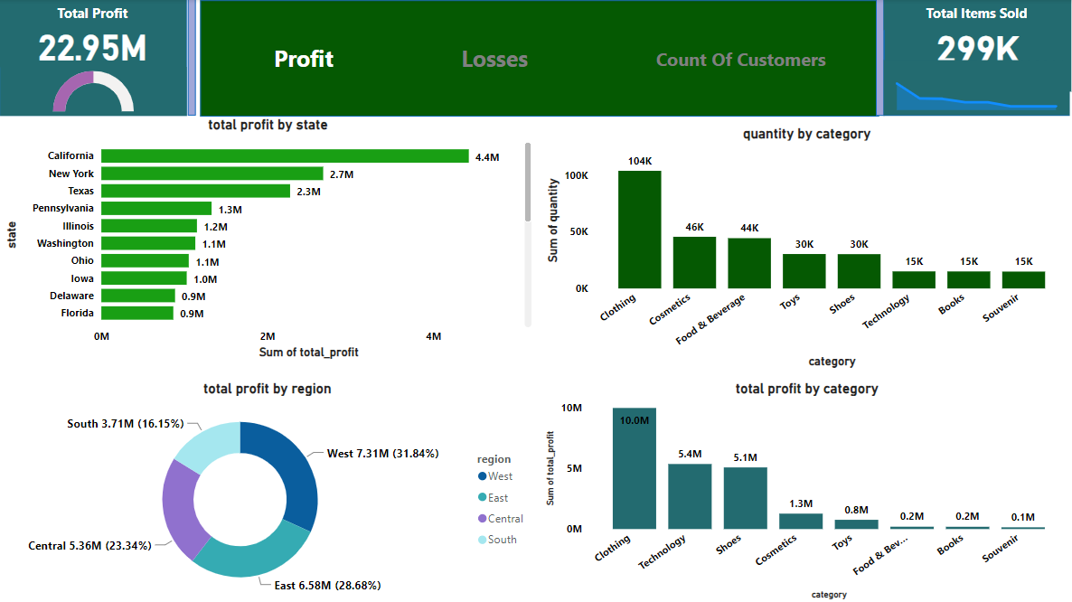
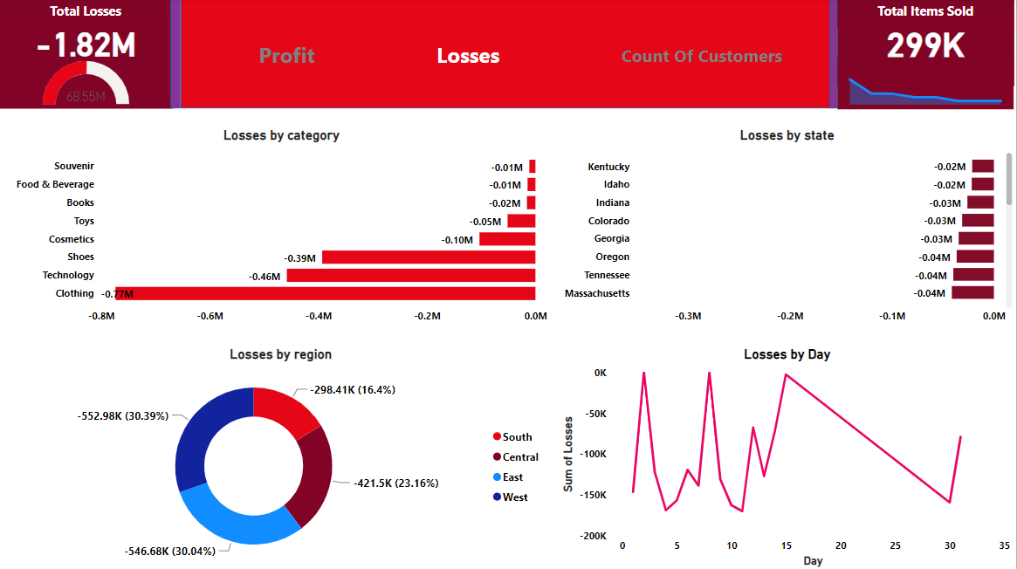
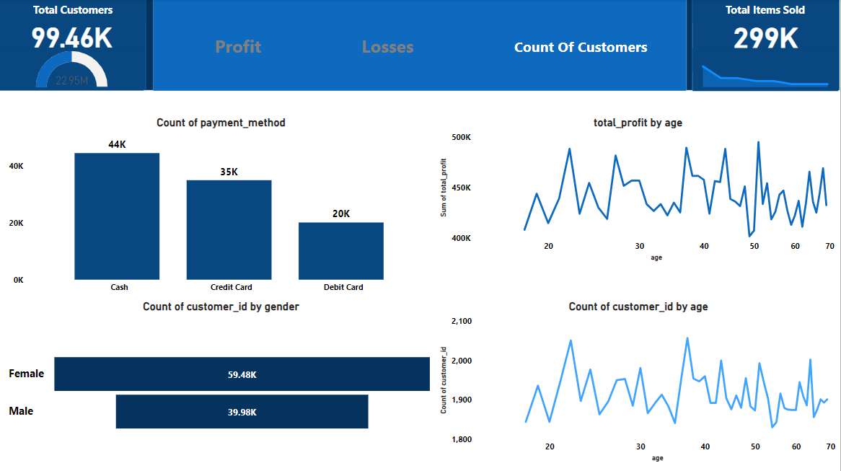
This dashboard provides a snapshot of a store's sales performance :
Total Profit : The store made $22.95 million in profit.
Total Items Sold: 299,000 items were sold.
Profit by State : California leads with $4.4M, followed by New York at $2.7M.
Profit by Region : The West region is the most profitable at $7.31M (31.84% of total), with East, Central, and South following.
Quantity by Category: Clothing is the most sold category with 104K items, while souvenirs are the least at 15K.
Profit by Category : Clothing brings in the most profit at $10M, while souvenirs bring in the least at $0.1M.
The data suggests a strong emphasis on clothing for both sales volume and profit

Slide 5

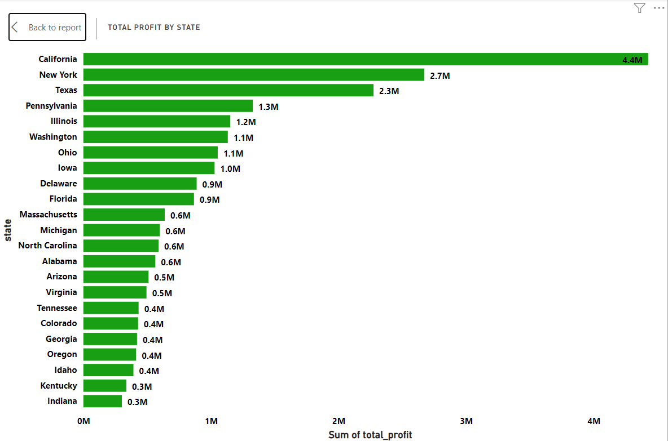
This dashboard details the losses of the same store:
Total Losses: The store incurred $1.82 million in losses.
Losses by Category: Clothing leads to losses at $0.77M, followed by Technology at $0.46M.
Losses by Region: The South has the highest losses at $552.98K, which is 30.39% of total losses.
Losses by State: Massachusetts has the highest individual state loss at $0.04M.
Losses by Day: There's a fluctuating loss pattern with some days reaching up to $200K in losses.
Despite high profits in clothing sales, it also accounts for the largest category of losses

Slide 6

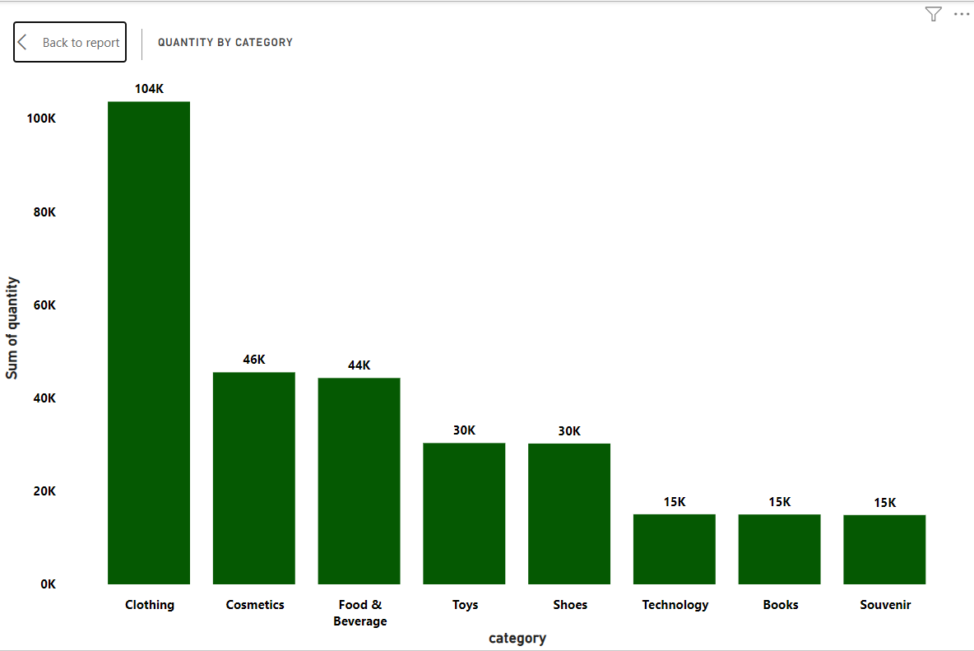
This segment of the dashboard provides customer and payment insights :
Total Customers: 99.46K customers made purchases.
Payment Methods: Cash was the most used payment method (44K), followed by credit cards (35K) and debit cards (20K).
Customer Gender: More females (59.48K) than males (39.98K) shopped at the store.
Profit by Age: The line graph shows fluctuations in profit across different ages, without a clear trend or age group dominating in profitability.
Customer Count by Age: A similar line graph indicates the count of customers across age groups, showing variability but no dominant age group.
Cash is the most preferred payment method, and females make up a larger portion of the customer base. Age does not show a consistent pattern in relation to profit or customer count.User

Slide 7

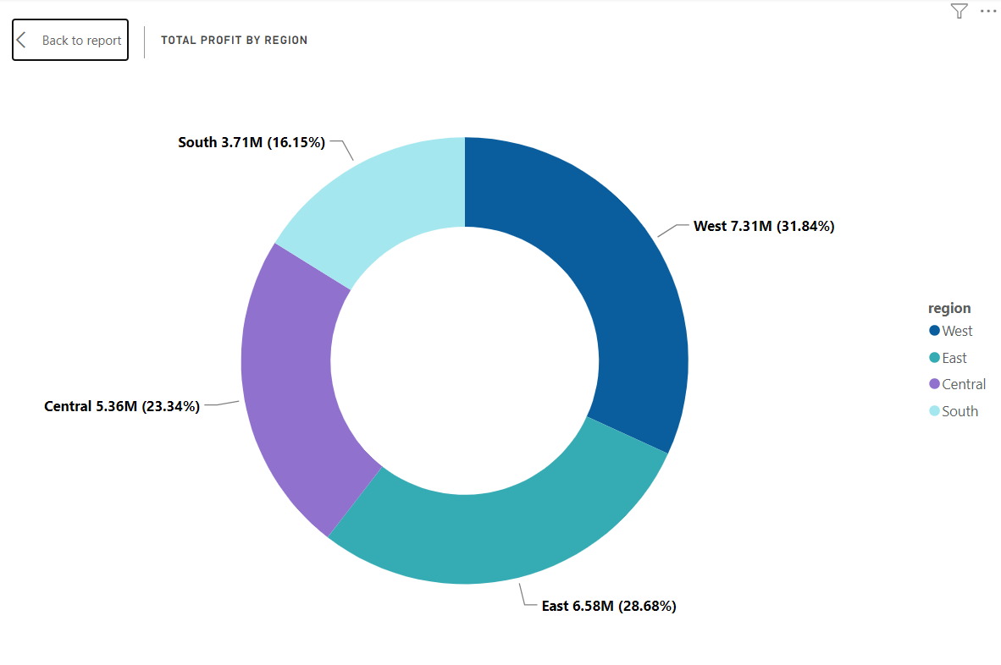
The chart shows the profit generated by each state for the store :
Top Performers: California ($4.4M) and New York ($2.7M) are the highest profit-generating states.
Middle Tier: States like Pennsylvania, Illinois, Washington, and Ohio are in the middle profit range, around $1.0M to $1.3M.
Lower Tier: Several states like Kentucky and Indiana are at the lower end with $0.3M in profit.
There is a clear disparity between the top-performing states and others, indicating a possible focus area for market strategy

Slide 8

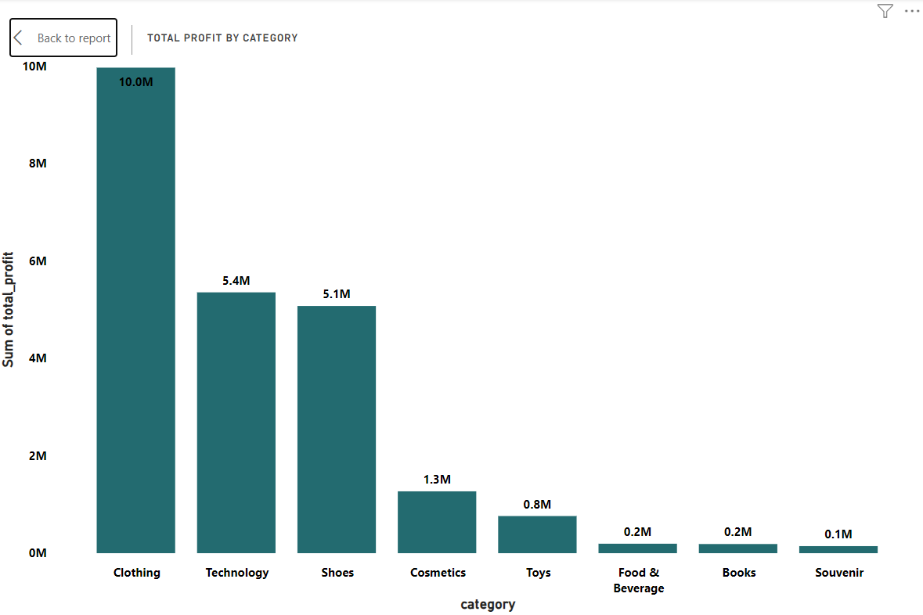
This bar chart depicts the quantity of items sold by category:
Clothing is the most popular category with 104K items sold.
Cosmetics and Food & Beverage follow with 46K and 44K items respectively.
Toys, Shoes, Technology, Books, and Souvenir are less popular, each with 30K or 15K items sold.
The chart highlights Clothing as the most sold category by a significant margin.

Slide 9

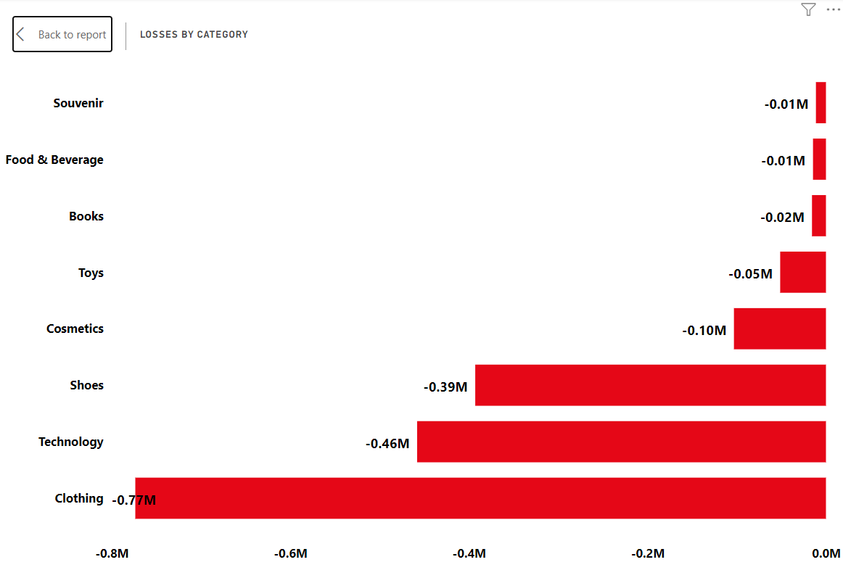
The donut chart provides a breakdown of total profit by region:
West: Highest profit at $7.31M, which is 31.84% of the total.
East: Second with $6.58M in profit, 28.68% of total.
Central: $5.36M in profit, 23.34% of the total.
South: The least profitable with $3.71M, making up 16.15% of total profits.
The West region is the most significant contributor to profit, followed closely by the East. The South region, while still profitable, contributes the least.

Slide 10

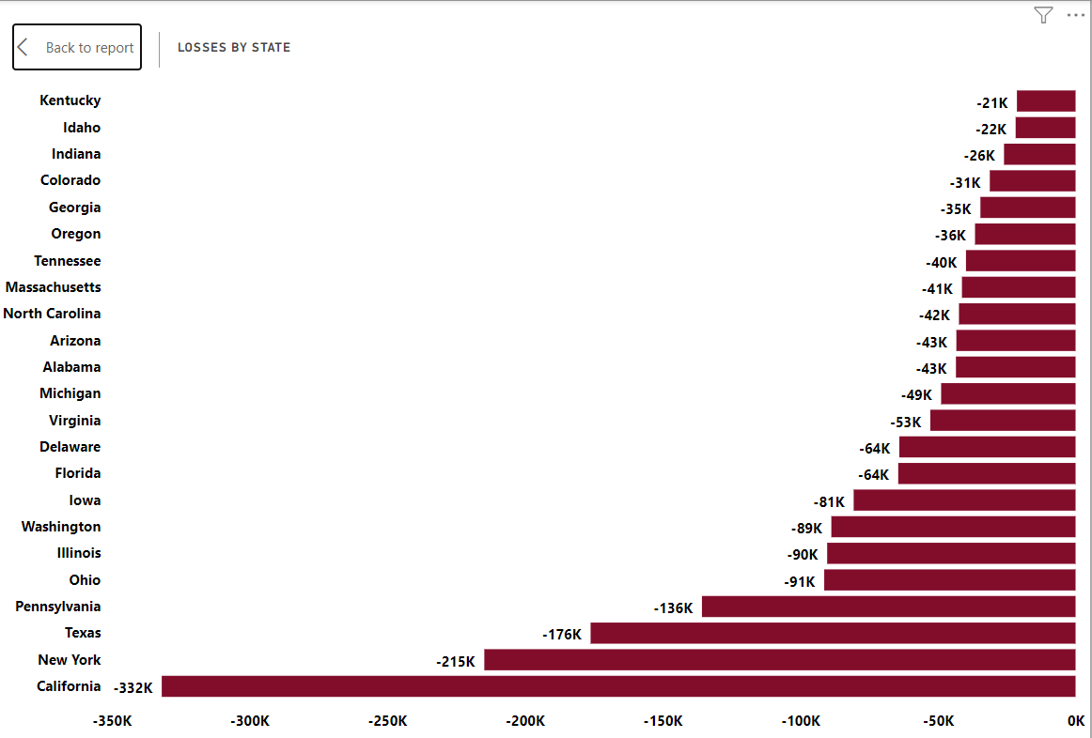
This bar chart shows the profit generated by each product category :
Clothing is the most profitable category, generating $10M.
Technology and Shoes are also significant, with $5.4M and $5.1M respectively.
Cosmetics, Toys, Food & Beverage, Books, and Souvenir bring in lower profits, ranging from $1.3M to $0.1M.
Clothing stands out as the top contributor to the store's profit.

Slide 11

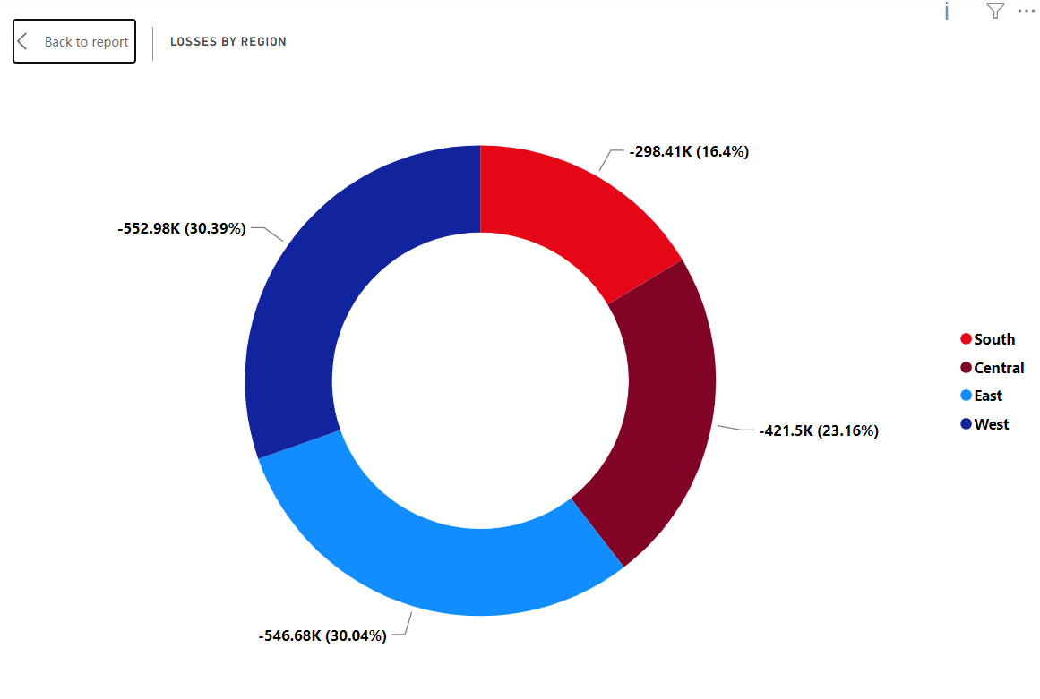
This bar chart outlines the losses incurred by each product category:
Clothing shows the highest loss at $0.77M.
Technology and Shoes follow with losses of $0.46M and $0.39M, respectively.
Cosmetics, Toys, Books, Food & Beverage, and Souvenir categories show smaller losses, ranging from $0.10M to $0.01M.
Although Clothing was the most profitable category, it also has the highest losses, which could indicate high sales volumes with significant markdowns or returns.

Slide 12

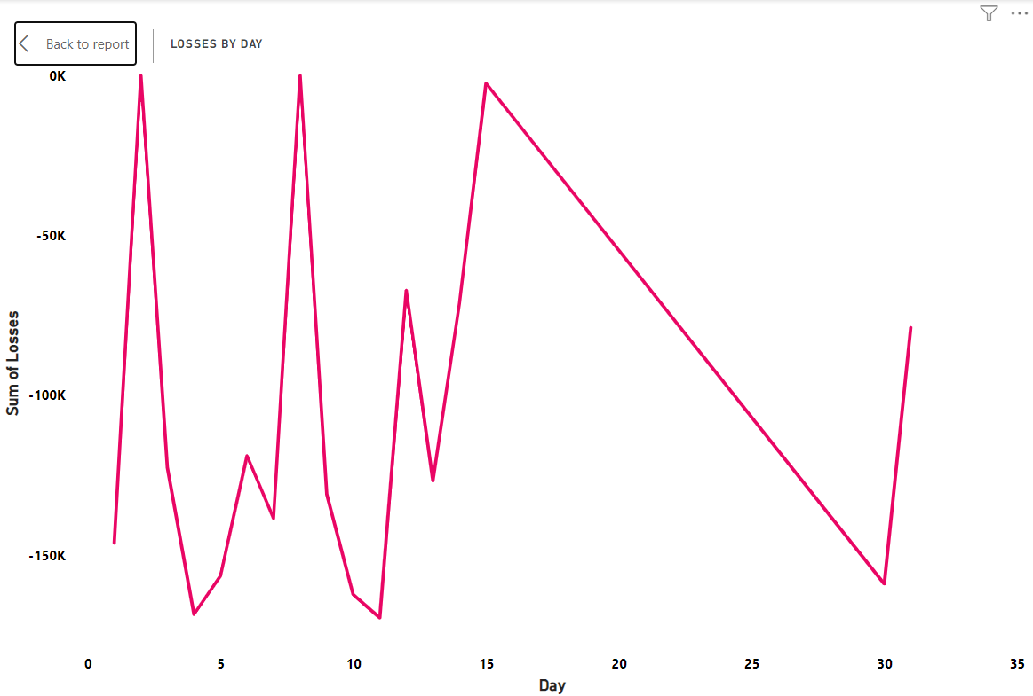
The bar chart outlines losses incurred by the store, categorized by state:
California shows the most significant losses at -$332K.
New York, Texas, Pennsylvania, Ohio, and Illinois also experience substantial losses, ranging from -$91K to -$215K.
Smaller States: Kentucky, Idaho, and Indiana have the least losses, from -$21K to -$26K.
California, despite its high profits, also incurs the largest losses, which may suggest a high cost of operations or other financial inefficiencies in that state.

Slide 13

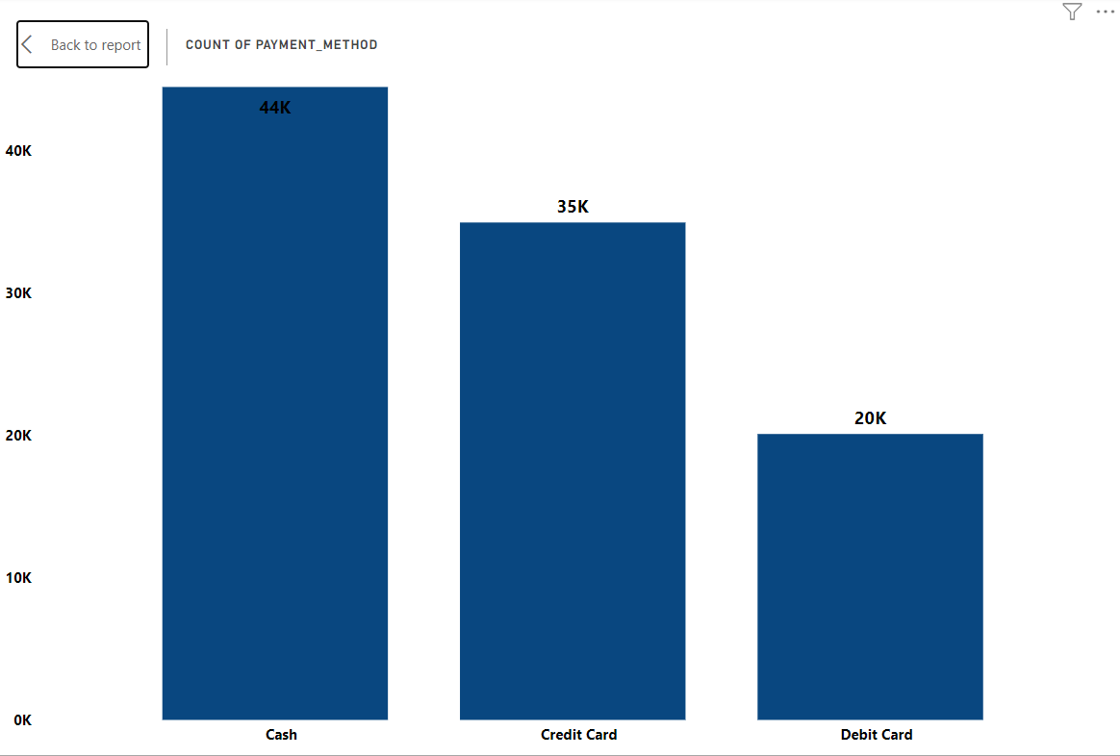
The donut chart displays the distribution of losses by region:
South: Highest losses at -$552.98K (30.39%).
Central: -$546.68K (30.04%).
West: -$421.51K (23.16%).
East: Lowest losses at -$298.41K (16.4%).
The South and Central regions are nearly tied for the highest losses, with the East region incurring the least. This contrasts with the profit distribution where the West was highest.

Slide 14

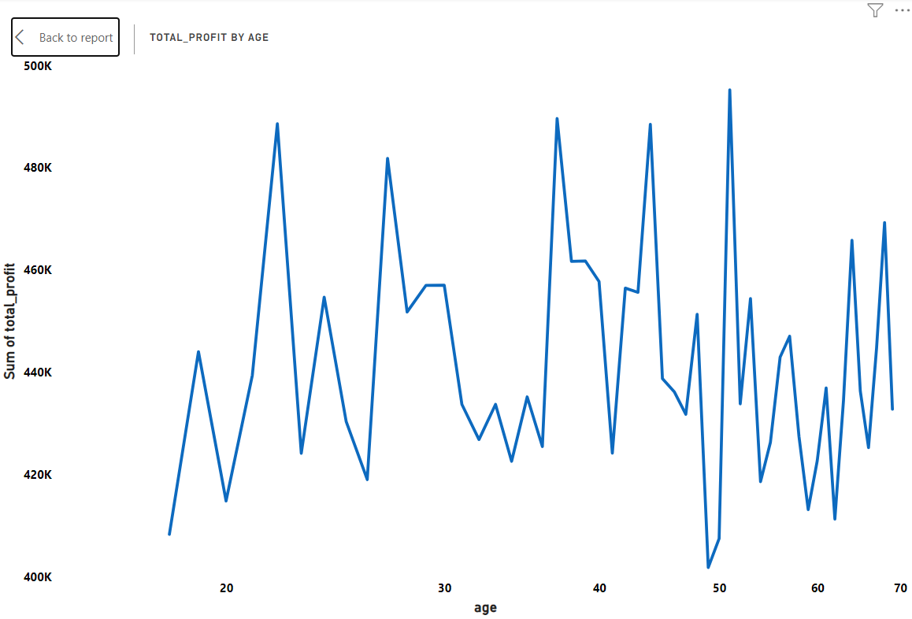
The line graph depicts losses by day over a period, possibly a month:
There are sharp fluctuations in daily losses, with some days showing significant dips up to -$150K.
The graph shows a notable downward trend towards the end of the period, indicating an increase in losses.
The variability suggests inconsistent performance, which might be due to various factors such as sales promotions, restocking issues, or operational challenges on specific days.

Slide 15

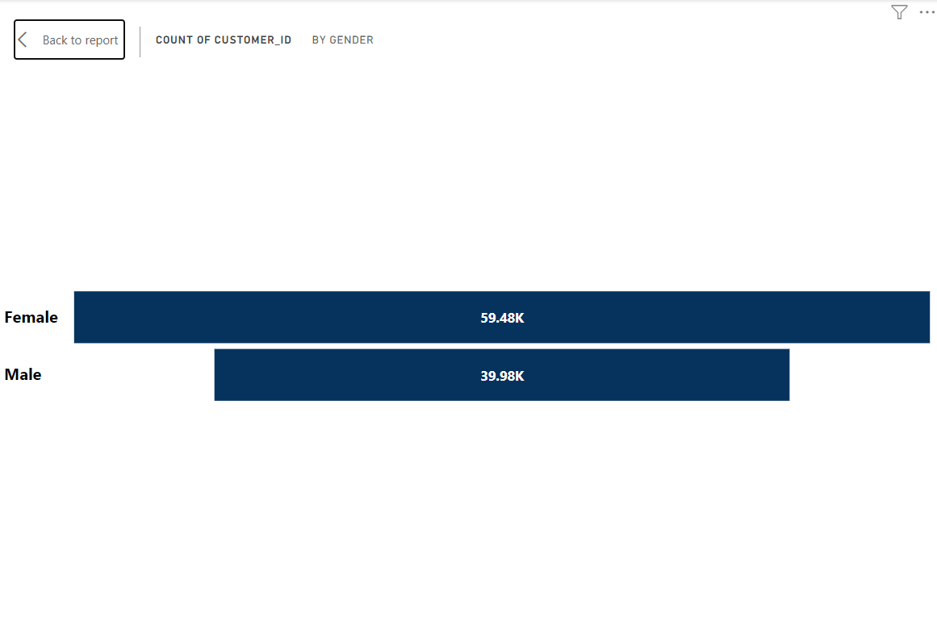
The bar chart displays the count of payment methods used:
Cash: Most popular, used 44K times.
Credit Card: Second most common, 35K uses.
Debit Card: Least used, with 20K occurrences.
Cash transactions are the leading payment method for this store.

Slide 16

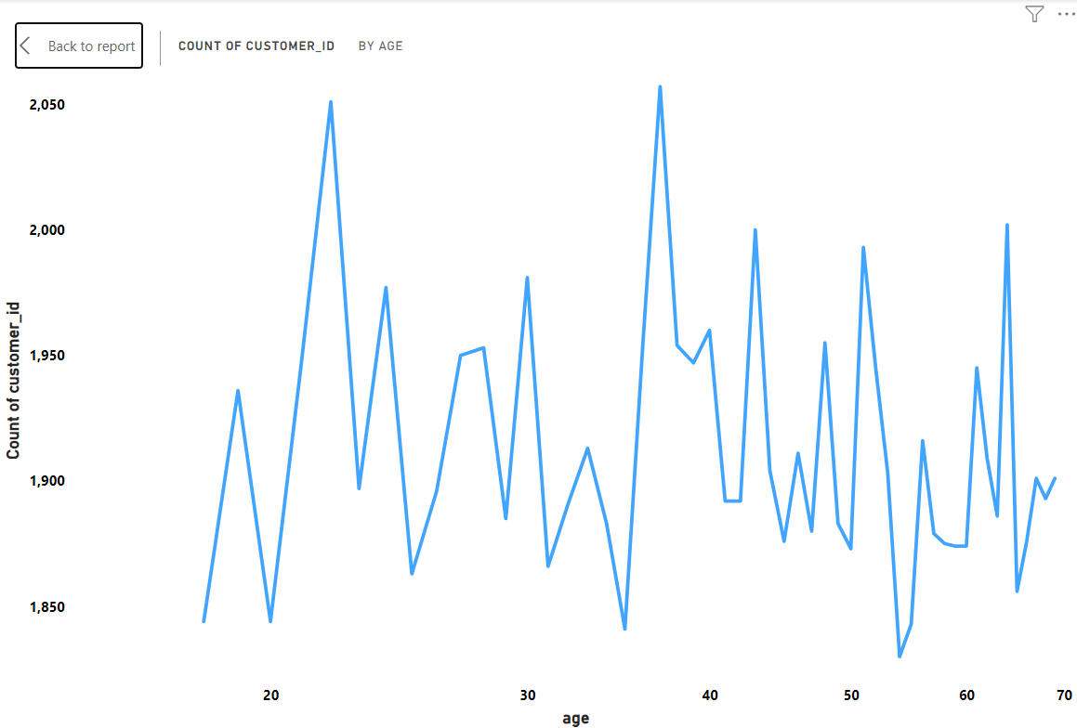
The line graph shows total profit by customer age:
There are significant fluctuations in profit across different ages.
No single age group consistently outperforms others, indicating a diverse age demographic contributing to profit.
Peaks and troughs are scattered throughout, suggesting that purchasing power and preference may vary greatly within the customer base.
This data might be useful for targeted marketing and sales strategies across different age groups.

Slide 17
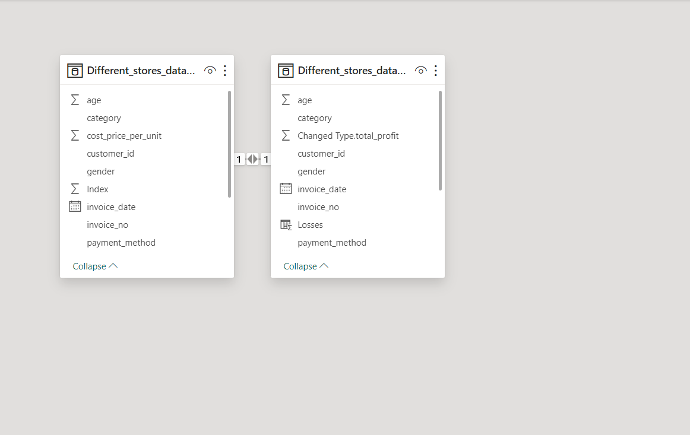
The bar chart represents the customer count by gender:
Female: There are 59.48K female customers.
Male: The count of male customers is 39.98K.
The chart indicates that female customers are more prevalent than male customers for this store.

Slide 18

The line graph represents the count of customers by age:
There are noticeable variations in the customer count across different ages.
No single age group consistently dominates in terms of customer count.
There are several peaks that might indicate age groups with a slightly higher number of customers, although these differences do not appear to be very pronounced.
The customer base seems diverse in age, with various age groups represented similarly.

Slide 19

The screenshot shows two lists of data columns, presumably from a database or spreadsheet for different store data. They include common fields like age, category, customer_id, gender, and payment method. Unique to the right list is 'Changed Type.total_profit' and 'Losses', indicating losses has been formatted or calculated differently than in the original data set.

Slide 20

Conclusion
The analysis revealed that while clothing is the most profitable and the most sold category, it also accounts for the most significant losses, indicating a need for inventory and pricing strategy refinement. Customer demographics showed a higher female clientele, with cash being the most preferred payment method. The age distribution of customers did not display a specific trend, suggesting a broad market appeal. Regional analysis indicated the West as the most profitable region, while the South and Central regions experienced higher losses. These insights could be leveraged to tailor marketing campaigns, optimize product assortments, and enhance operational efficiencies.

